Slide 1


Battle of Neighborhood
Place Suggestions to moving crowd

Slide 2
Introduction
When someone or a family is trying to find the best places to live, it's always a good idea to compare the cities and, if possible, compare the neighborhoods to see if they suit your taste. After all, when you're going to buy a car or a house or a big-ticket item, you 're usually going to try out a couple of models or visit a couple of homes before you decide.
Overall Comparison
Crime Rates
Neighborhood Comparison

Slide 3
Data
The dataset for this project consists of information on cities in the USA gathered from https:/simplemaps.com/data/us-cities. Specifically, the data includes: City Name, County Code, County Name, Population, I d, Latitude , Longitude, Source, State Address, State Name, and Time Zone. The table was used to geocode the data to determine the right coordinates. The data was then exported and translated into a file, read into a pandas data container, and transformed into a file. Mecklenburg sliced data for use in the project. In addition to these results, the Foursquare API was used to gather positions near communities for cluster analysis to be conducted on the results.

Slide 4
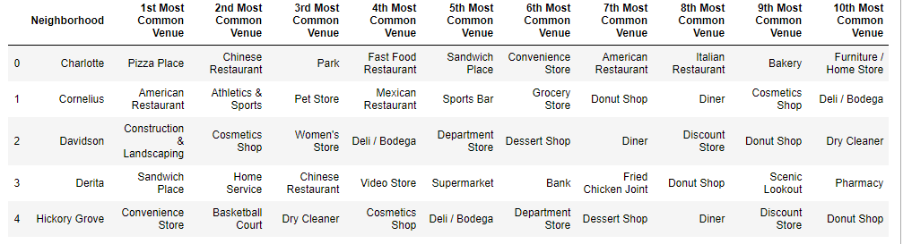
Results:

Slide 5
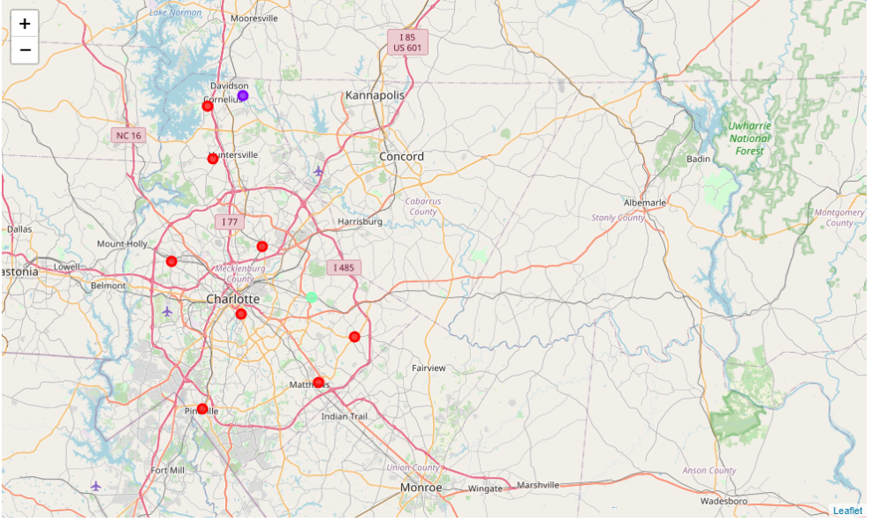

Slide 6
Conclusion
The aim of this work is to provide the necessary facilities to help people decide the best way to live or move if they think about it.
Visualization and the Foursquare API for community data processing, it is possible to cluster city data on the basis of proven and agreed machine learning techniques – K-Means Algorithm.
These tests must be considered constrained by the nature of the data set used, since there is no information provided about the origins of the data set. Such results will be of interest to people or citizens whose aim is to compare different neighborhoods when thinking about relocation or vacationing in a different environment , given the ease of access to a number of locations within a clustered setting.

Slide 7
There is definitely plenty of room for improvement. For example, to collect more than the existing community positions to evaluate and cluster a wide variety of geographical locations. We may also use and evaluate crime data – which is freely accessible to all counties – to help provide enough space for decision-making about the option of place to move. This knowledge can be particularly helpful because we definitely may not choose to stay in a crime-ridden community. Although the approach used here may not be vigorous enough, it nevertheless shows the usefulness of a neighborhood data analysis.

